Slide 1
Flow Networks

Slide 2
Practical examples of a network
- liquids flowing through pipes
parts through assembly lines
current through electrical network
information through communication network
goods transported on the road…

Slide 3
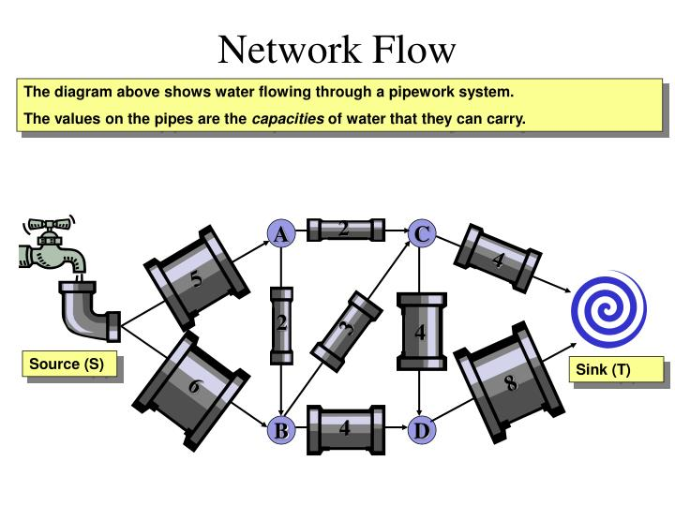

Slide 4
Flow Graph
Use a graph to represent a “flow network” and use it to answer questions about material flows
Flow is the rate that material moves through the network
Each directed edge is a conduit for the material with some stated capacity
Vertices are connection points but do not collect material
  Flow into a vertex must equal the flow leaving the vertex, flow conservation

Slide 5
Flow Concepts
Source vertex s
  where material is produced
Sink vertex t
  where material is consumed
For all other vertices – what goes in must go out
  Flow conservation

Slide 6
Formal Max Flow Problem
  Graph G=(V,E) – a flow network
    Directed, each edge (u,v) ∈ E has a nonnegative capacity c(u,v) >= 0. if (u,v) ∉ E , we assume that c(u,v) = 0.
    Two special vertices: source s, and sink t
    For any other vertex v, there is a path s→…→v→…→t
Goal: determine maximum rate of material flow from source to sink

Slide 7
Properties of Flow
Flow: A flow in G is a real-valued function f : V × V → R that satisfies three properties:
1. Capacity constraint : For all u,v ∈ ς, we require f(u,v) ≤ c(u,v).
The net flow from one vertex to another must not exceed the given capacity.
2. Skew symmetry : For all u,v ∈ ς, we require f(u,v) = -f(v,u).
The net flow from a vertex u to a vertex v is the negative of the net flow from v to u.
3. Flow conservation : For all u ∈ ς - {s,t}, we require
∑ f(u,v) = 0.
v ∈ ς
The value of the flow is defined as | f | = ∑ f(s,v) that is the total net flow out of the source. v ∈ ς

Slide 8
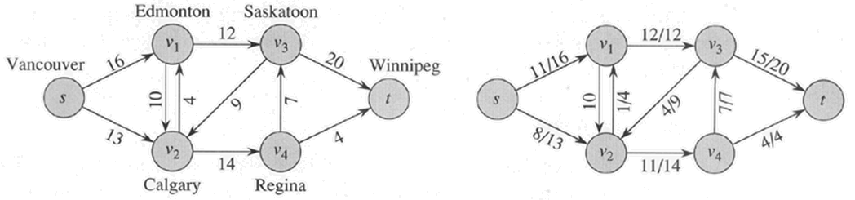
Max Flow
We want to find a flow of maximum value from the source to the sink
  Denoted by |f|
Lucky Puck Distribution Network
Max Flow, |f| = 19
Or is it?
Best we can do?

Slide 9
Cancellation of flows
We would like to avoid two positive flows in opposite directions between the same pair of vertices
  Such flows cancel (may be partially) each other due to skew symmetry
2/15
a
5/19
2/15
a
5/19
s
2/9
5/5
t
s
9
t
3/5
5/14
b
2/3
5/14
b
2/3

Slide 10
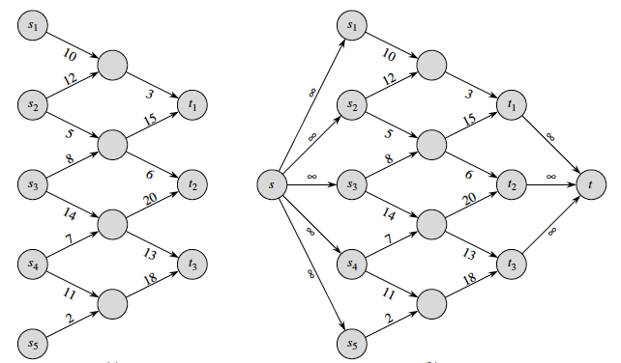
Multiple Sources or Sinks
Modify the graph to create a single supersource (s) and supersink (t)

Slide 11
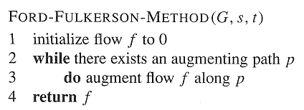
Ford-Fulkerson method
Contains several algorithms:
  Residual networks
  Augmenting paths

Slide 12
Residual Capacity
Given a flow f in network G = (V, E).
Consider a pair of vertices u, v ∈ V.
Residual capacity:
    The amount of additional flow we can push directly from u to v, before exceeding the capacity.
  c_{f} (u, v) = c(u, v) − f (u, v)
  ≥ 0 (since f (u, v) ≤ c(u, v))
Example:
  c(u,v) = 16, f(u,v) = 5 ➔ c_{f} (u, v) = 11

Slide 13
Residual Network
Residual network: G_{f} = (V, E_{f} ),
E_{f} = {(u, v) ∈ V × V : c_{f} (u, v) > 0} .
Each edge of the residual network (residual edge) can admit a positive flow.
Given flows f₁ and f₂, the flow sum
f₁ + f₂ is
  (f₁ + f₂)(u, v) = f₁(u, v) + f₂(u, v)
  for all u, v ∈ V.

Slide 14
Residual Graph
Compute the residual graph of the graph with the following flow:
a
8/13
b
10/15
13/19
s
10
9
5/5
t
2/4
6/14
c
8/11
d
3/3

Slide 15
Augmenting Path
Finding an Augmenting Path
  Find a simple path from s to t in the residual graph G_{f}
  The residual capacity of a path p in G_{f}:
  c_{f}(p) = min{c_{f}(u,v): (u,v) is in p}
    i.e. find the minimum capacity along p
  Doing augmentation: for all (u,v) in p, we just add this c_{f}(p) to f(u,v) (and subtract it from f(v,u))
  Resulting flow is a valid flow with a larger value.

Slide 16
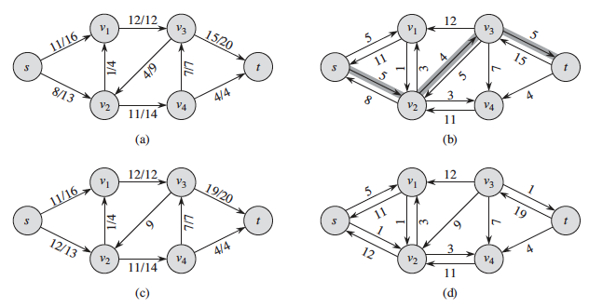
Residual network and augmenting path
Flow Network
Residual Network

Slide 17
The Ford-Fulkerson algorithm
Ford-Fulkerson(G,s,t)
1 for each edge (u,v) in G.E do
2 f(u,v) ← f(v,u) ←0
3 while there exists a path p from s to t in residual network G_{f} do
4 c_{f} = min{c_{f}(u,v): (u,v) is in p}
5 for each edge (u,v) in p do
6 f(u,v) ←f(u,v) + c_{f}
7 f(v,u) ← -f(u,v)
8 return f

Slide 18
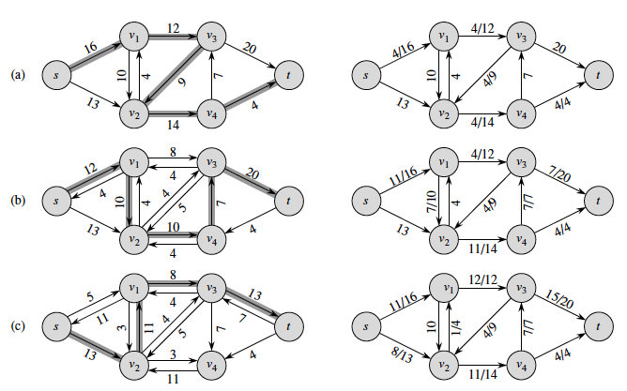
Execution of Ford-Fulkerson (1)
Left Side = Residual Graph Right Side = Augmented Flow

Slide 19
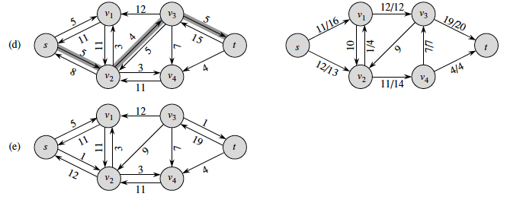
Execution of Ford-Fulkerson (2)
Left Side = Residual Graph Right Side = Augmented Flow

Slide 20
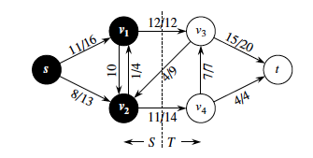
Cuts
  A cut (S,T) is a partition of V into S and T = V – S, such that s ∈ S and t ∈ T
  The net flow (f(S,T)) through the cut is the sum of flows f(u,v), where u ∈ S and v ∈ T
  The capacity (c(S,T)) of the cut is the sum of capacities c(u,v), where u ∈ S and v ∈ T
  Minimum cut – a cut with the smallest capacity of all cuts.
  |f|= f(S,T) i.e. the value of a max flow is equal to the capacity of a min cut.
  Net flow across the cut = 12 + -4 + 11 = 19
  Capacity = 12 + 14 = 26

Slide 21
Max-Flow Min-Cut Theorem
The following conditions are equivalent:
1. f is a maximum flow in G.
2. The residual network G_{f} contains no augmenting paths.
3. | f | = c(S, T ) for some cut (S, T) of G.
Proof
(1) ⇒ (2): If there were augmenting paths this would contradict that we found the maximum flow of G.
(2) ⇒ (3): If G_{f} has no augmenting path, G_{f} contains no path from s to t. Define
S = {v ∈ V : there exists a path from s to v in G_{f} } and T = V − S.
The partition (S, T) is a cut. For each pair of vertices u and v such that
u ∈ S and v ∈ T, we have f(u, v) = c(u, v), since otherwise (u, v) ∈ E_{f}. Therefore, | f | = f (S, T) = c(S, T ).
(3) ⇒ (1): | f | = f (S, T) ≤ c(S, T) for all cuts (S, T). The condition | f | = c(S, T ) implies that f is a maximum flow.

Slide 22
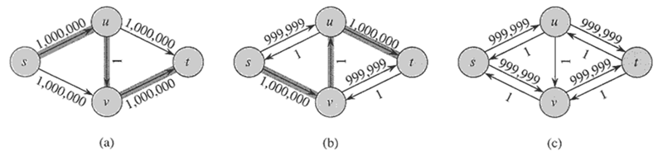
Worst Case Running Time
Assuming integer flow
Each augmentation increases the value of the flow by some positive amount.
Each augmentation path can be found in O(E).
Total worst-case running time O(E|f*|), where f* is the max-flow found by the algorithm.
Example of worst case:
Augmenting path of 1
Resulting Residual Network
Resulting Residual Network

Slide 23
Application – Bipartite Matching
Example – given a community with n men and m women
Assume we have a way to determine which couples (man/woman) are compatible for marriage
  E.g. (Joe, Susan) or (Fred, Susan) but not (Frank, Susan)
Problem: Maximize the number of marriages
  Can solve this problem by creating a flow network out of a bipartite graph

Slide 24
Bipartite Graph
  Given an undirected graph G = (V, E), a matching is a subset of edges M ⊆ E such that for all vertices v ∈ V, at most one edge of M is incident on v.
  A maximum matching is a matching of maximum cardinality.
  A bipartite graph is an undirected graph G=(V,E) in which V can be partitioned into two disjoint sets V₁ and V₂ such that (u,v) ∈ E implies either u ∈ V₁ and v ∈ V₂ or vice versa.
  That is, all edges go between the two sets V₁ and V₂ and not within V₁ and V₂.

Slide 25
Model for Matching Problem
Men on leftmost set, women on rightmost set, edges if they are compatible
A
A
X
A
X
X
B
B
B
Y
Y
Y
C
C
C
Z
Z
D
Z
D
D
Men
Women
A matching
Maximum matching

Slide 26
Solution Using Max Flow
Add a supersouce, supersink, make each undirected edge directed with a flow of 1
A
A
X
X
B
B
t
Y
s
Y
C
C
Z
Z
D
D
G=(V,E)
G' =(V,E')
Since the input is 1, flow conservation prevents multiple matchings

